Slide 1
Rockbuster Stealth Database Insights
March 2022

Slide 2
Objective
Facing stiff competition from streaming services such as Netflix and Amazon Prime, the Rockbuster Stealth management team is planning to use its existing movie licenses to launch an online video rental service in order to stay competitive
To help develop and launch a strategy for the new online video service, the following business questions will be addressed:
  Which movies contributed the most/least to revenue gain?
  What was the average rental duration for all videos?
  Which countries are Rockbuster customers based in?
  Where are customers with a high lifetime value based?
  Do sales figures vary between geographic regions?

Slide 3

Key Film Statistics
1,000 total films
$61,312 in total revenue
Distributed in 108 countries
599 unique customers
20 genres: Action, Animation, Children, Classics, Comedy, Documentary, Drama, Family, Foreign, Games, Horror, Music, New, Sci-Fi, Sports, Travel, Thriller, Crime, Romance, War
5 ratings: G, PG, PG-13, NC-17, R
Inventory | Inventory
 | Rental Duration | Rental Rate | Movie Length | Replacement Cost
AVERAGE | 5 Days | $2.98 | 115 min | $19.98
MIN | 3 Days | $0.99 | 46 min | $9.99
MAX | 7 Days | $4.99 | 185 min | $29.99

Slide 4
The Sports genre has the highest sales overall, followed by Sci-Fi and Animation

Slide 5
The most profitable movies should be brought into the new online platform, while the least profitable could be dropped, to maximize revenue

Slide 6
The ten countries with the most customers make up over half of total revenue
Revenue (Top 10) | Number of Customers
 | 60
 | 53
 | 36
 | 31
 | 30
 | 28
 | 28
 | 20
 | 15
 | 14
$61,312
Total Revenue

Slide 7
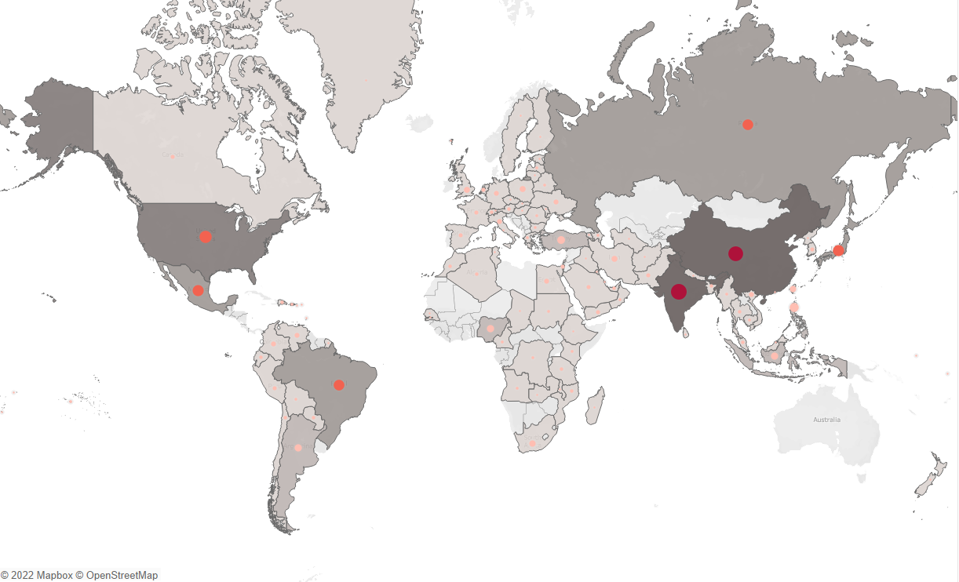
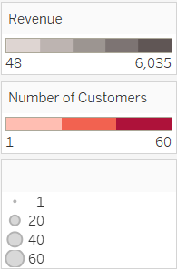
Sales tend to be highest in Asia and North America, particularly India, China, and the US, and lowest in Africa and Western Europe

Slide 8
Recommendations
Bring over the most popular films and films from high-profit genres to the new streaming service and consider removing the least popular to maximize sales revenue while lowering overall costs of maintaining additional licenses (full list of film and genre revenue available for further analysis)
Focus marketing and promotional efforts in the regions with the largest customer base: Asia and North America
  Additionally, marketing strategies in countries with lower revenue should be reviewed and adjusted accordingly. If budget allows, test new campaigns to spark interest in the new platform worldwide
Reward loyal customers with discounts and free film rental opportunities to further encourage word of mouth recommendations
Offer free trials on new platform
Consider bundling discounts (i.e., sign up for monthly streaming service, get 20% off physical rentals of special films not included on streaming service)

Slide 9
Questions?
Rachel Stevens
Data Analyst
Rstevens@Rockbuster.com

